Slide 1
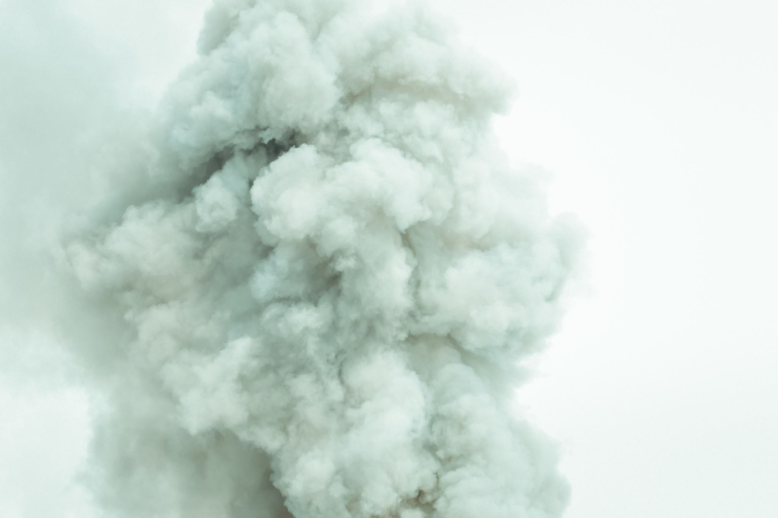







Advancing Wildfire Smoke Forecasting Across the CONUS
Yunyao Li (The University of Texas at Arlington)
Daniel Tong (GMU), Peng Xian (NRL), Kevin Cromar (NYU), Laura Myers (Kaiser), Barry Baker (NOAA), Ravan Ahmadov (NOAA), Anton Darmenov (NASA), Edward Hyer (NRL), Daniel Figueras Nieto (ECCC), Jack Chen (ECCC), Shihab Shahriar (UTA)

Slide 2
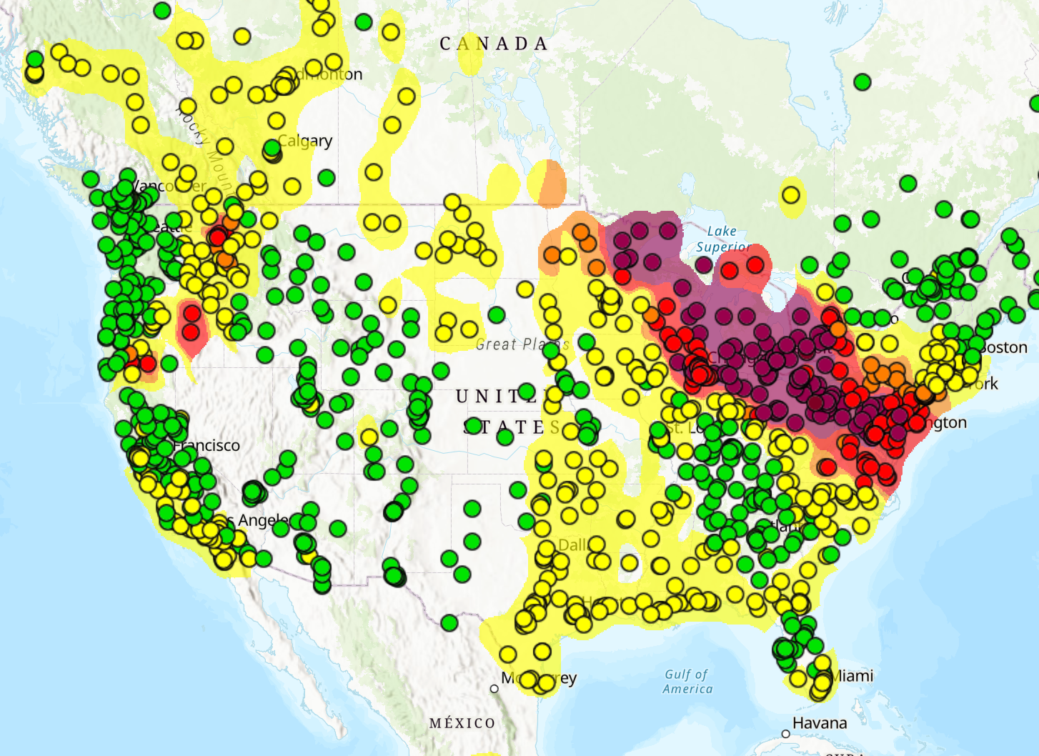
Why Do We Need Smoke Forecasts?
Wildfires emit large amounts of particulate matter and harmful gases.
Smoke can travel hundreds to thousands of kilometers, exposing populations far beyond the fire region.
Skillful forecasts provide time to act:
  Issue public-health alerts
  Protect vulnerable populations
  Plan outdoor activities and emergency responses
    Hospital and emergency response capacity
    School and workplace closures
    Evacuation and sheltering decisions
Jul 17, 2026: Canadian wildfire smoke affected air quality across the Great Lakes and northeastern United States. (from AirNow)

Slide 3
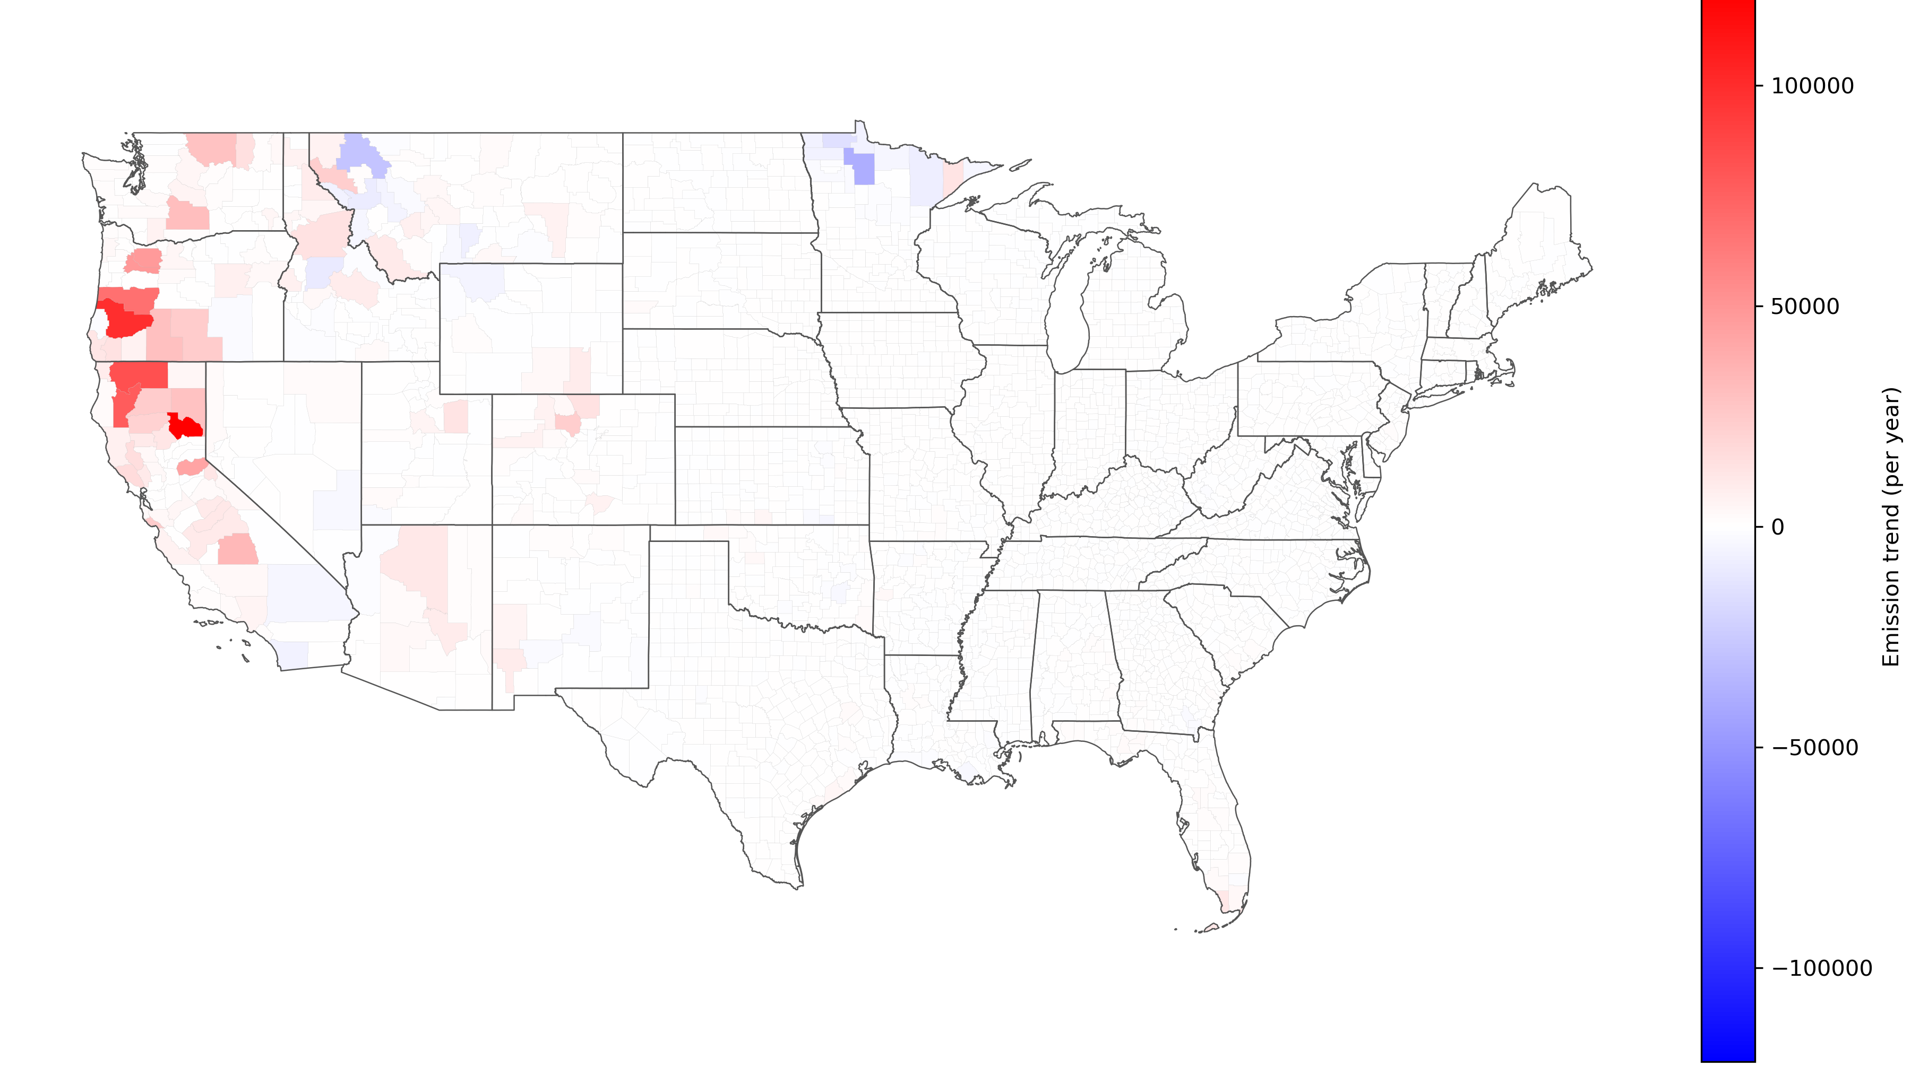
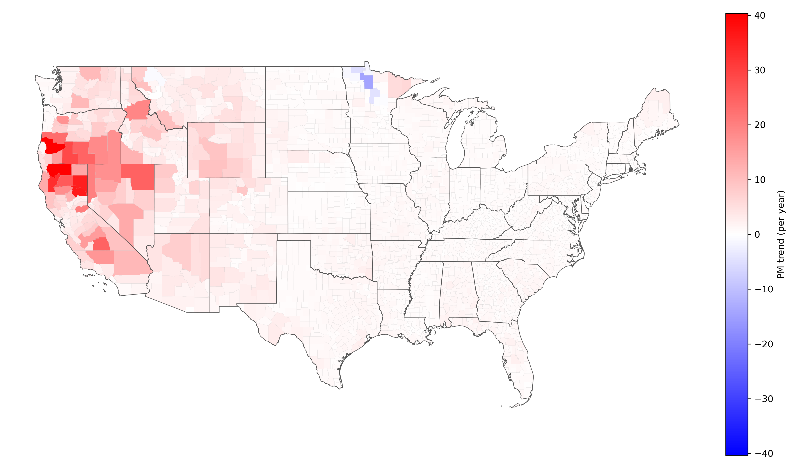
Wildfire Smoke: A Nationwide Challenge
Increasing fire emissions in the western United States.
Fire-induced PM₂.₅ is increasing across a much broader area due to long-range smoke transport.
20-Year Trend in Fire PM₂.₅ Emissions
20-Year Trend in Fire-Attributable Surface PM₂.₅
Broader downwind PM₂.₅ increases
(Results from GMU 20-yr North America Chemical Reanalysis (WRF-CMAQ) simulation with EPA NEI emission)

Slide 4
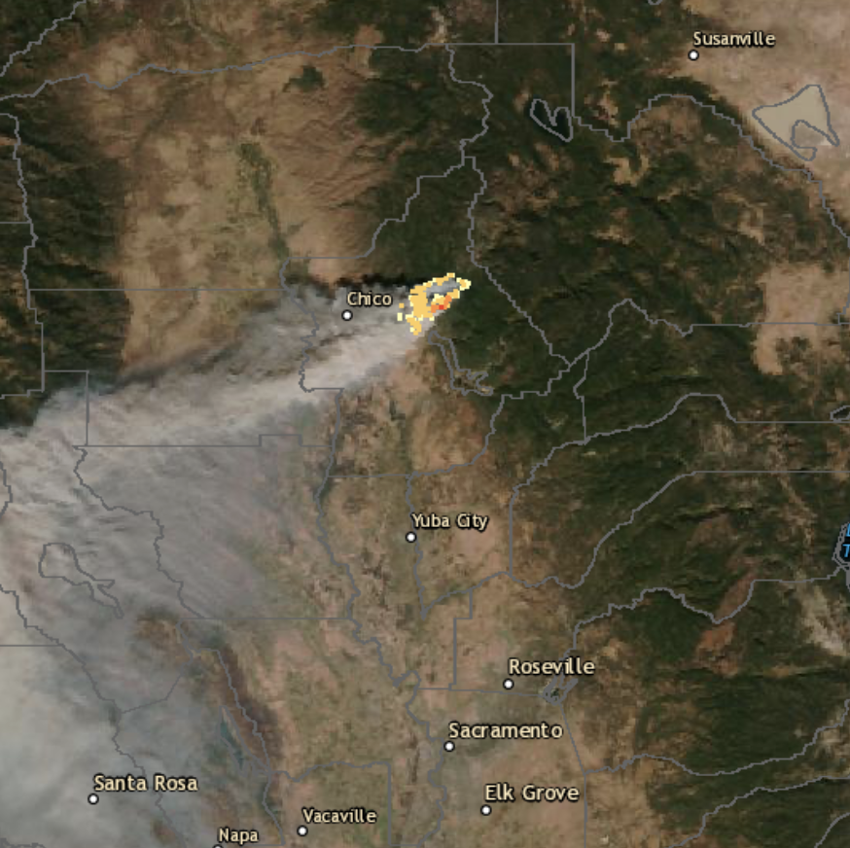
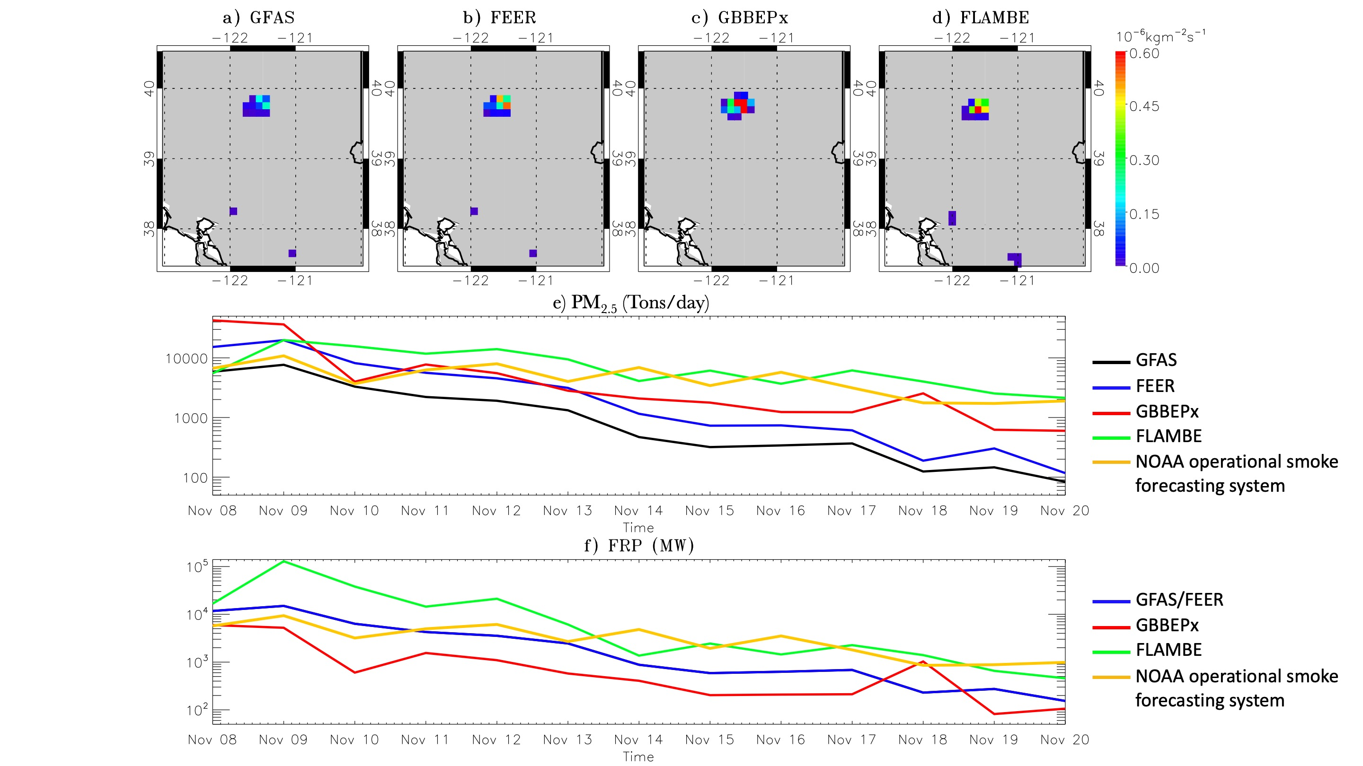
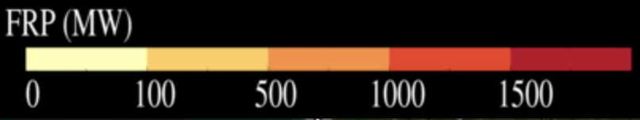
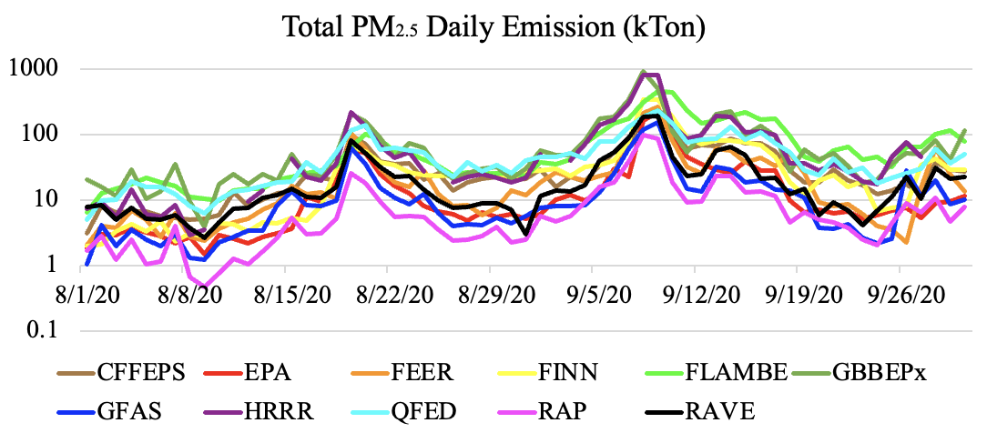

How Do We Forecast Wildfire Smoke?
$$E=\int{FRP}×β×F$$
Weather Forecast Model + Chemical Transport Model
Transport & Chemistry
Fire Radiative Power
Emission
Plume Rise
Concentration
Camp Fire 2018
Uncertainty enters at every step
Notes:
How do we forecast wildfire smoke? We first need to determine where fires are burning and how intensely they are burning, often using satellite-derived fire radiative power. FRP is then converted into fire emissions using assumptions about fuel type, combustion conditions and emission factors. A plume-rise model estimates how high the smoke is injected, and a chemical transport model uses meteorological forecasts to simulate transport, chemistry and vertical mixing, ultimately predicting surface PM₂.₅ concentrations.
However, uncertainty enters at every step. Different emission estimates can be produced for the same fire. The same emissions may be injected near the surface or high above the boundary layer. These differences propagate through the modeling system and can produce very different surface smoke forecasts.

Slide 5
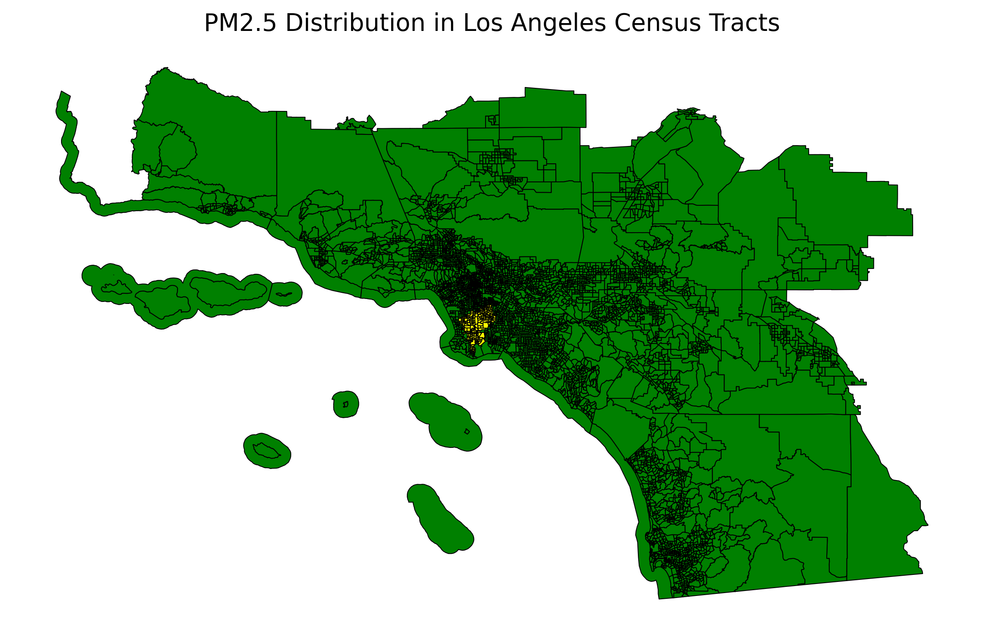
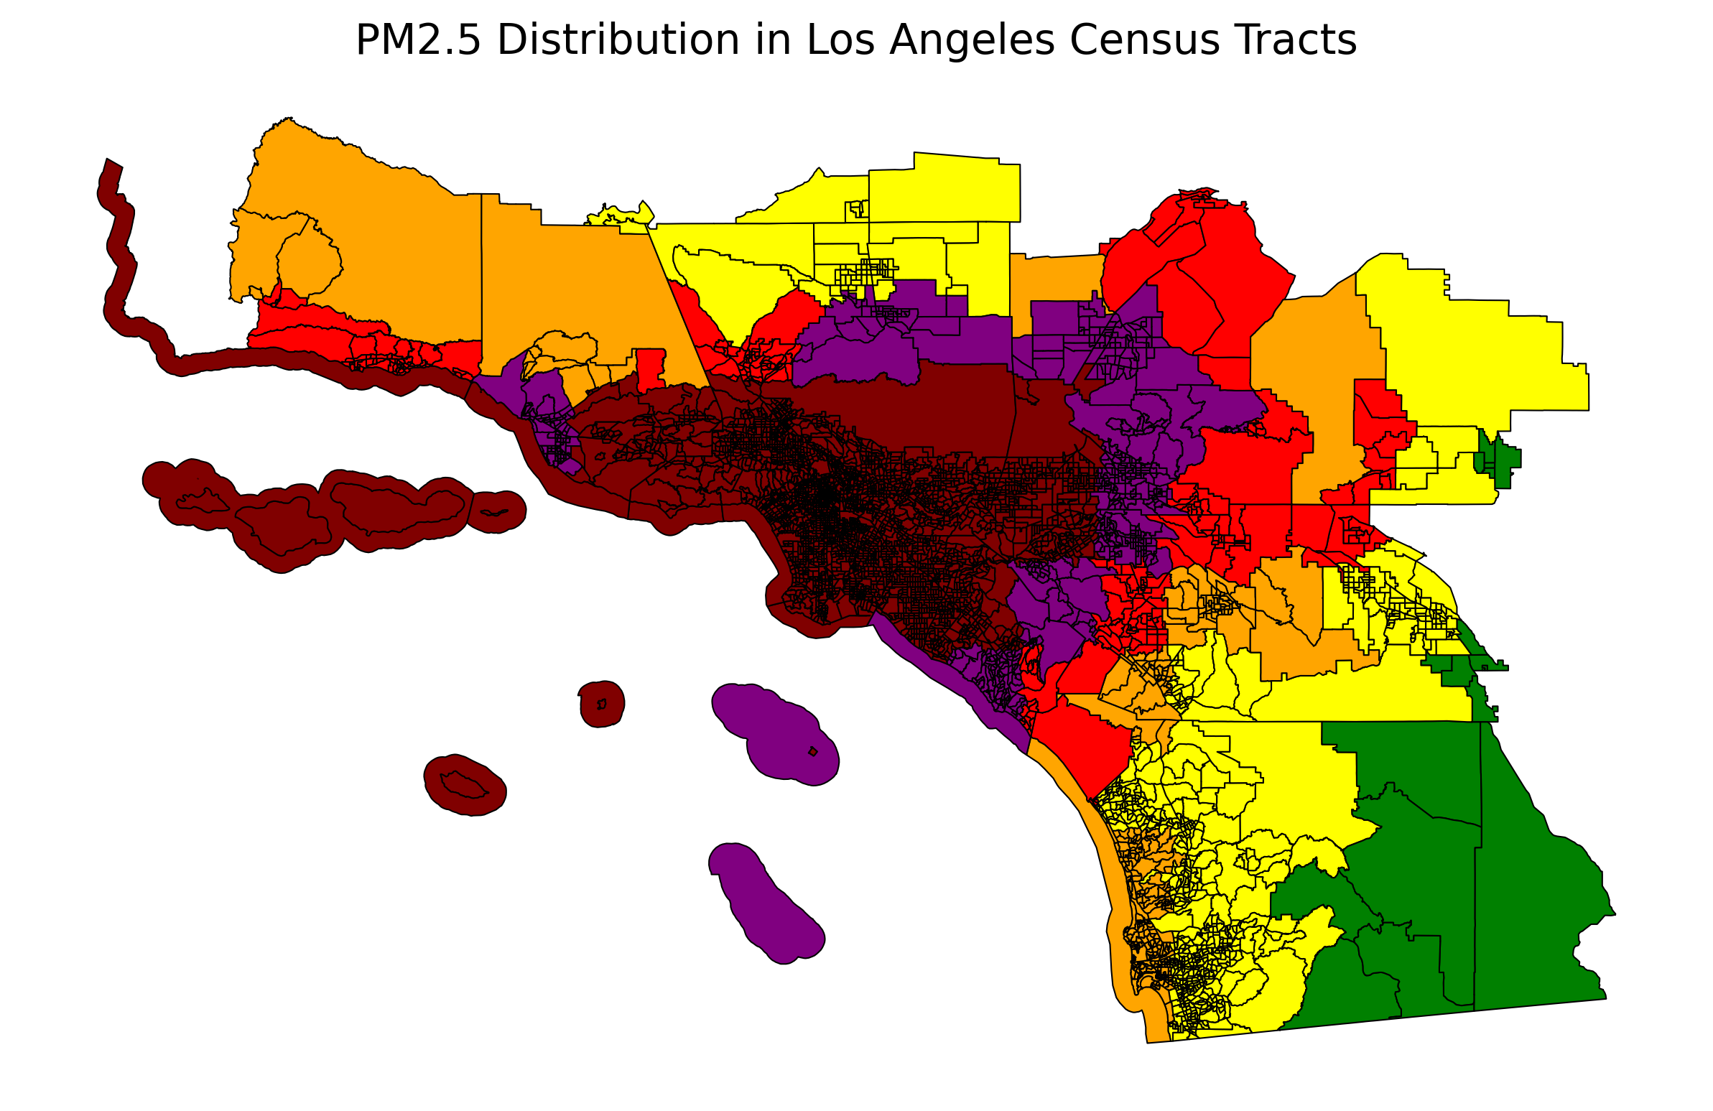
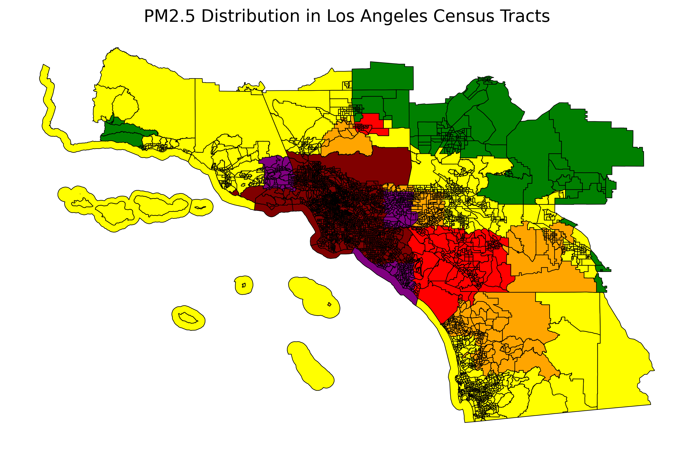
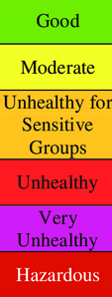


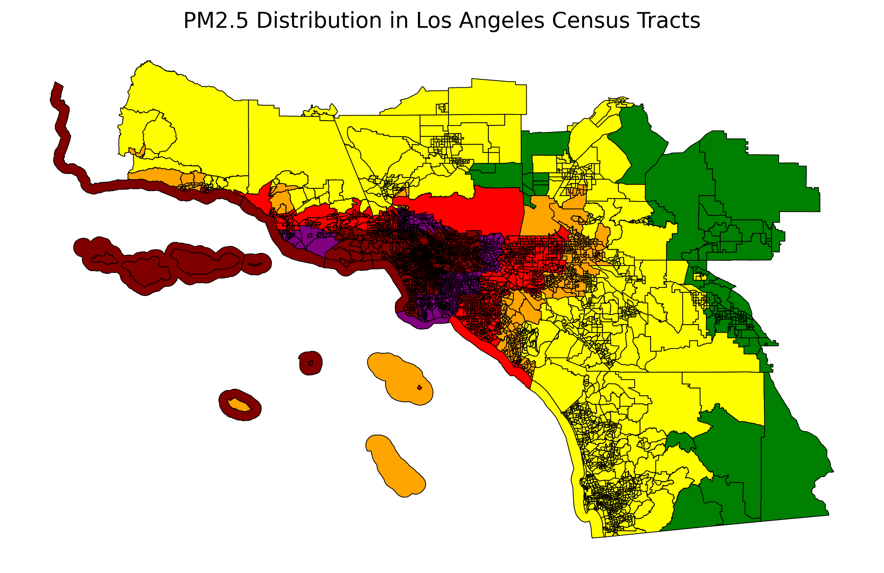
Wildfire Smoke Remain Difficult to Forecast
Operational models perform well overall but diverge substantially during wildfire events.
All models: 88–98% overall accuracy.
 | Accuracy%
Model-1 | 95.9
Model-2 | 98.1
Model-3 | 91.9
Model-4 | 95.9
Model-5 | 87.6
Model-6 | 98
Model-1
Model-2
Model-3
Model-4
Model-5
Model-6
(24-hour air quality forecast from six real-time models for Jan 9, 2025)

Slide 6
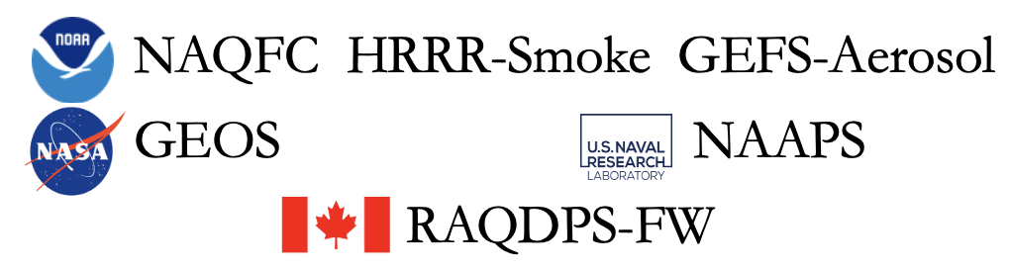
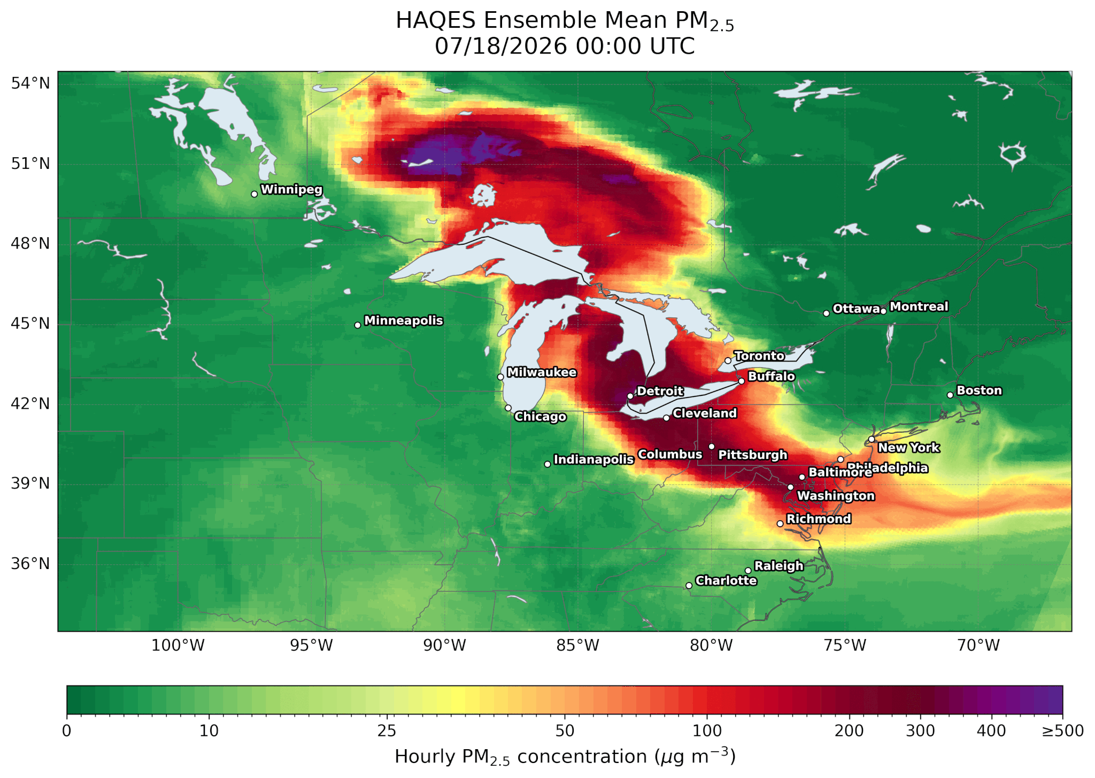
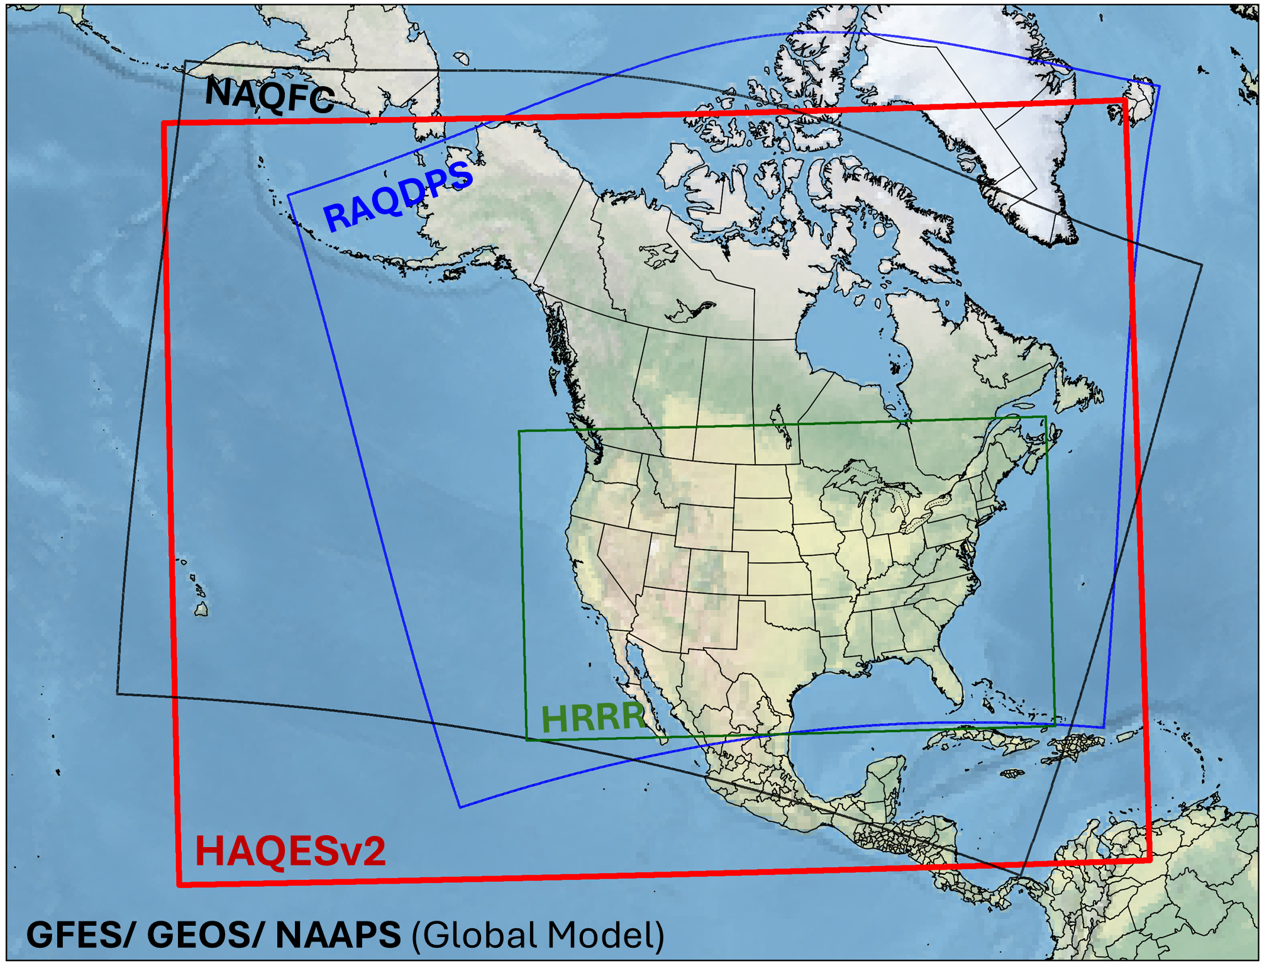
Hazardous Air Quality Ensemble System version 2 (HAQESv2)
Download Link: air.csiss.gmu.edu/yli/HAQES/
Multi-Model system including 6 operational forecast systems
System Overview
  Forecast Window: 48-hour forecast from 00 UTC the following day
  Temporal Resolution: Hourly
  Spatial Resolution: 3 km (NetCDF); Census tract levels (ASCII)
  Coverage: North America (CONUS, Canada, Alaska, Hawaii, Mexico)
  Output:
    1) Operational: Ensemble mean PM_{2.5} concentration; PM_{2.5} Exceedance Probability
    2) Testing: Weighted Ensemble PM_{2.5} concentration; PM_{2.5} Exceedance Index
HAQESv1

Slide 7
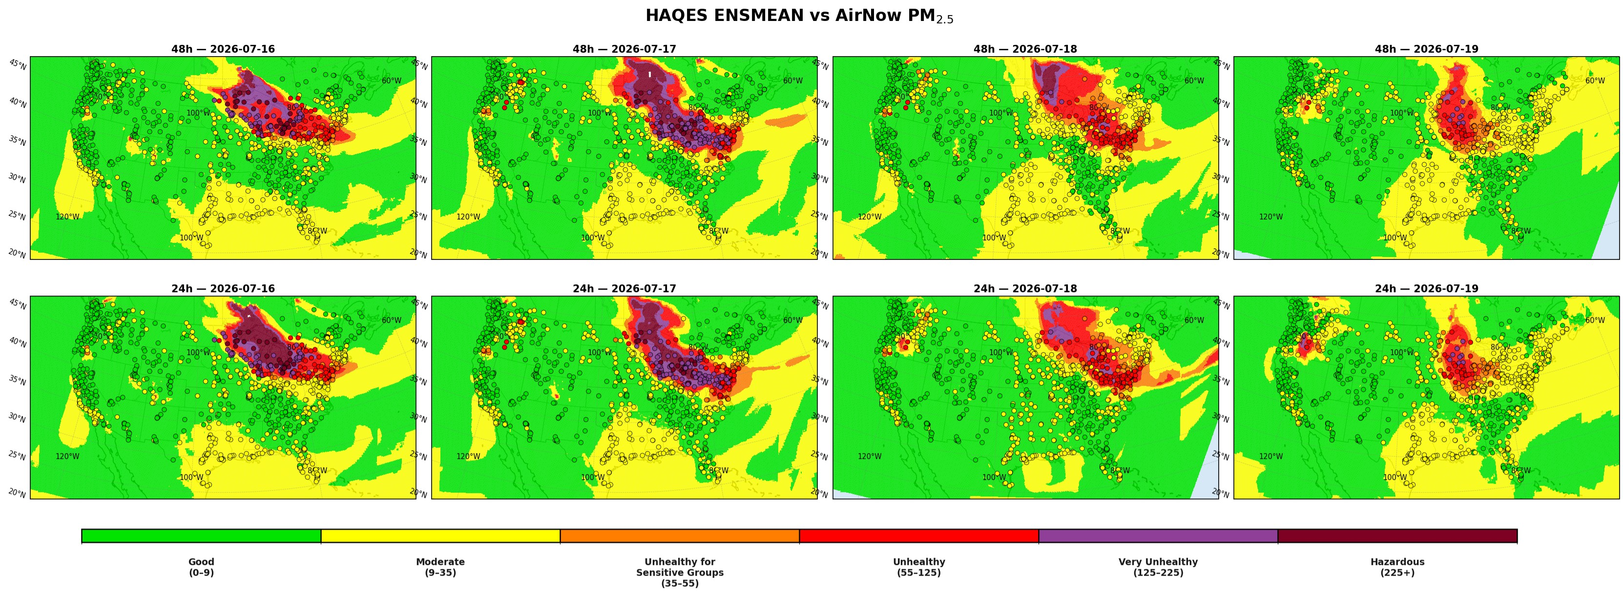
HAQES Captured the July 2026 Canadian Smoke Event
Valid Jul 16
Valid Jul 17
Valid Jul 18
Valid Jul 19
24-h Forecast
Init Jul 15
Init Jul 16
Init Jul 17
Init Jul 18
48-h Forecast
Init Jul 14
Init Jul 15
Init Jul 16
Init Jul 17
Good
(0-9)
Moderate
(9-35)
Unhealthy for Sensitive Groups (35-55)
Unhealthy
(55-125)
Very Unhealthy
(125-225)
Hazardous
(225+)
HAQES captured the smoke-transport pattern, with increasing uncertainty at longer lead times.
 | RMSE | CORR | Hit Rate | False Alarm
24 H | 26.2 | 0.82 | 0.83 | 0.1
48 H | 28.5 | 0.8 | 0.83 | 0.09
Colored background = HAQESv2
Colored circles = AirNow

Slide 8

What If Smoke Forecasts Triggered Health Alerts?
Hypothetical scenario based on the July 16, 2026 Canadian smoke event
24-h HAQES
PM_{2.5} Forecast
Smoke Alert
Issued before smoke arrives
Protective Action
Reduces personal exposure to≤35 µg m⁻³
165.9 million people could be correctly warned
(87% of the affected people)
76% potential reduction in PM_{2.5} exposure
Potential public health value of an actionable forecast.

Slide 9
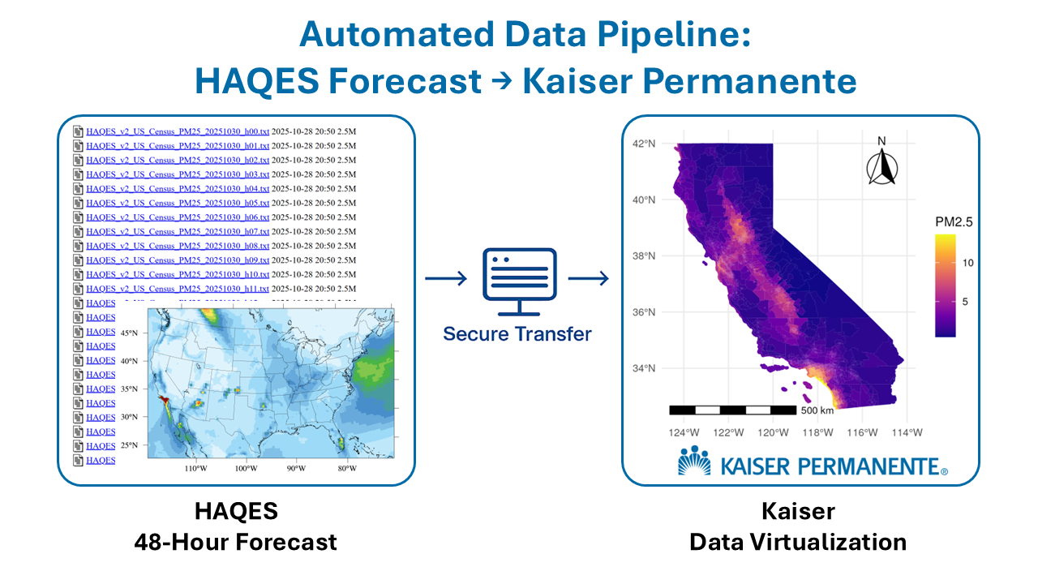
Kaiser Permanente Application
Collaborating with KP to develop a patient-centric messaging system based on the ensemble smoke forecast, enabling better real-time communication of air quality impacts to patients.
Kaiser
Data Visualization

Slide 10
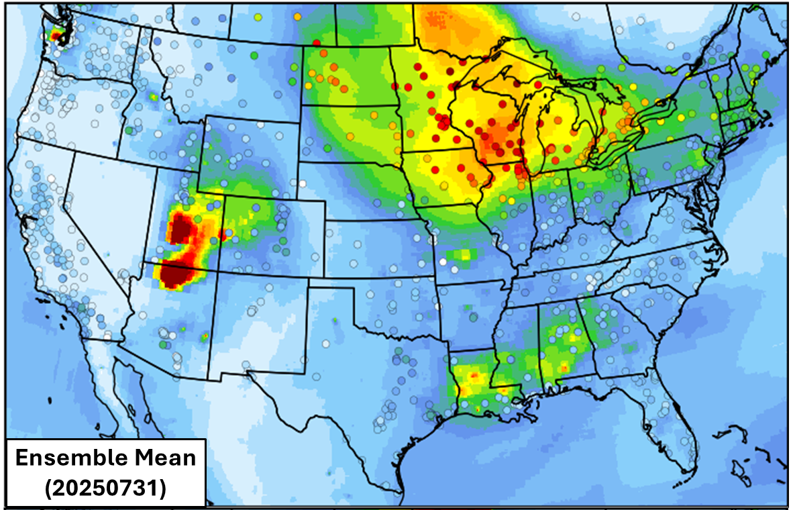
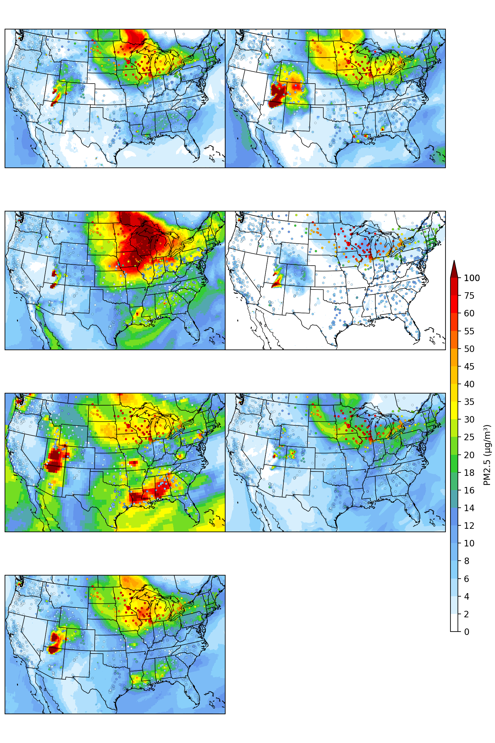
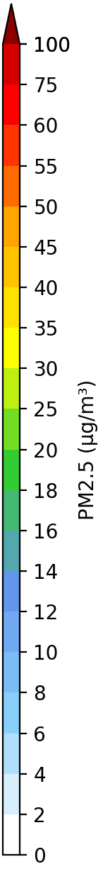
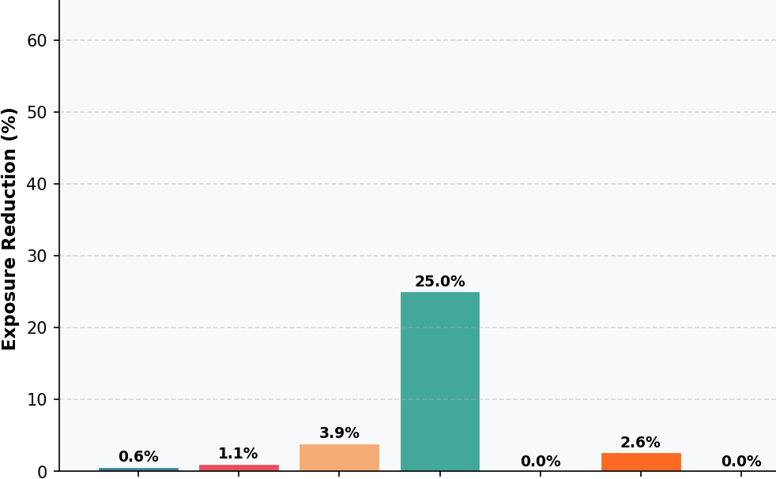
What if Models missed the plume?
HAQES missed the PM₂.₅ exceedance over Chicago
Potential Exposure Reduction (%)
HAQES
Model 1
Model 2
Model 3
Model 4
Model 5
Model 6
(24-hour air quality forecast from six real-time models for Jul 31, 2025)

Slide 11
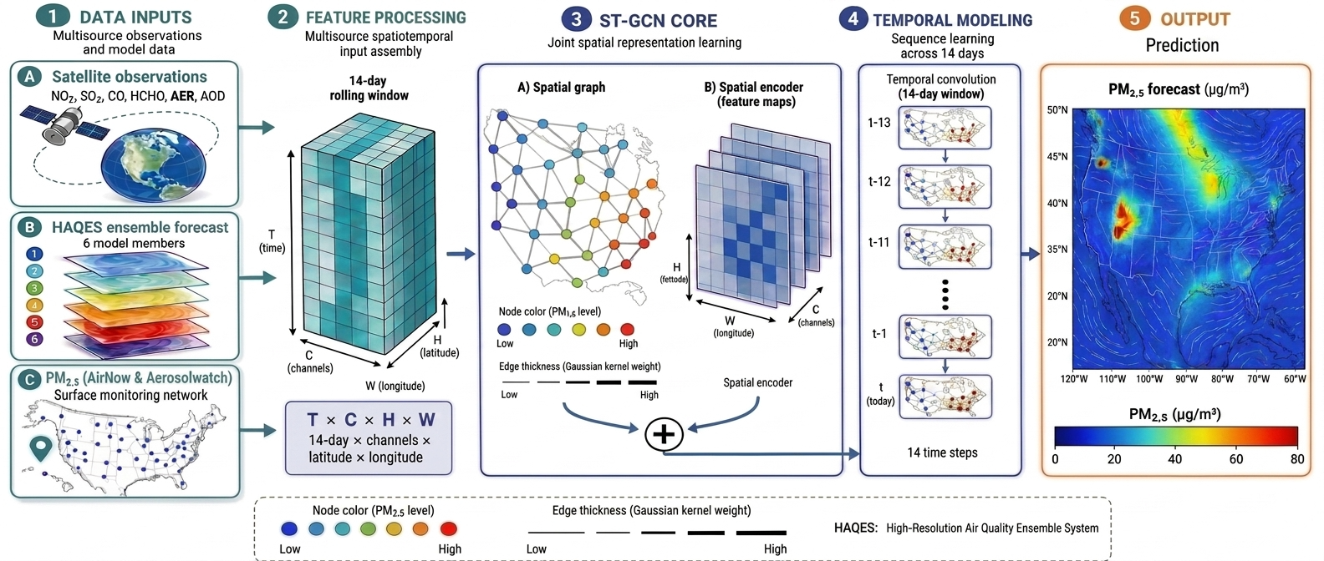
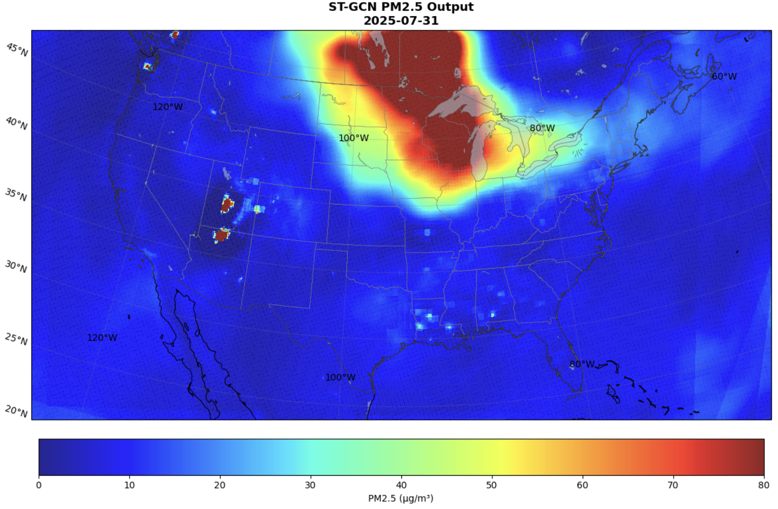
Solution 1: Observation-Informed AI Forecast
A spatiotemporal AI model combines six HAQES forecasts with the previous 14 days of AirNow and satellite observations to directly predict PM₂.₅.
Potential Exposure Reduction=56%
For July 31, 2025

Slide 12
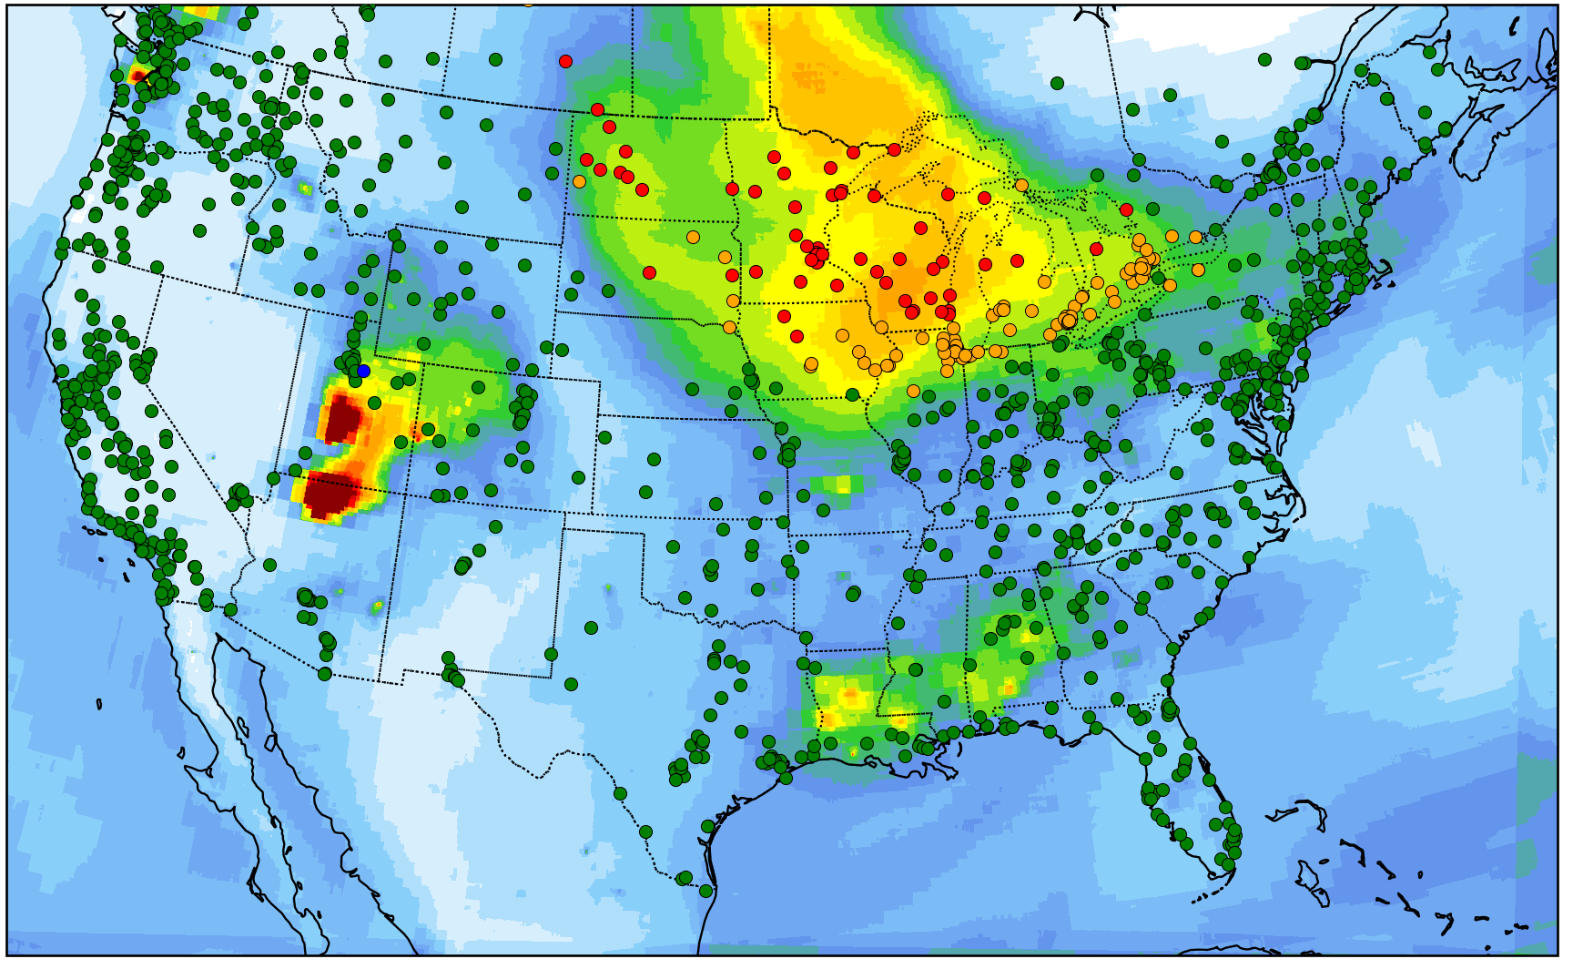
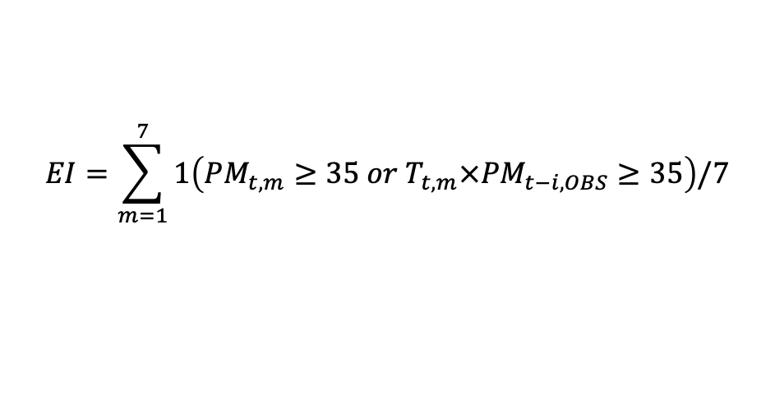
Solution 2: A Forecast Index for Decision Support
Bridging Forecasts and Decisions
Raw model output is not an alert decision.
We developed a PM₂.₅ Exceedance Index that integrates recent observations, model forecasts, and observed trends to support forecaster decision-making:
This index further enhances PM₂.₅ exceedance forecasting, delivering:
  Hit Rate: +84%
  False Alarms: -16%
  Overlap: +76%
Contour: Ensemble Mean (Dots: Excd Index)
$$EI=\sum_{m=1}^{7}{1\left({PM}_{t,m}≥35 or T_{t,m}×{PM}_{t−i, OBS}≥35\right)/7}$$

Slide 13
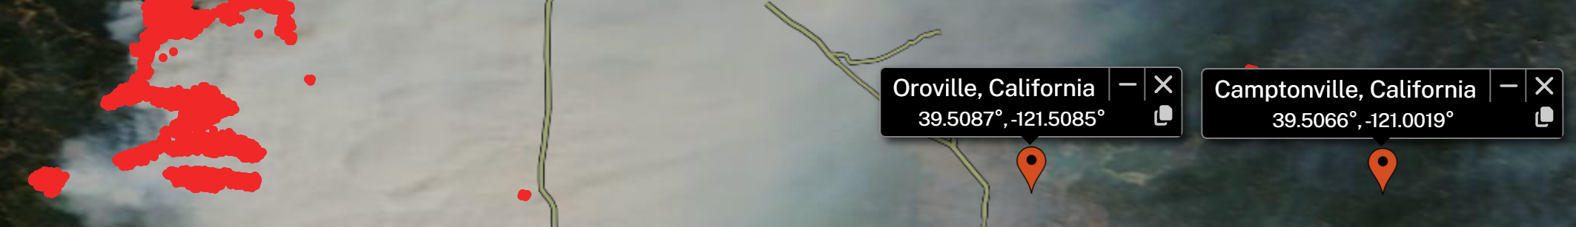
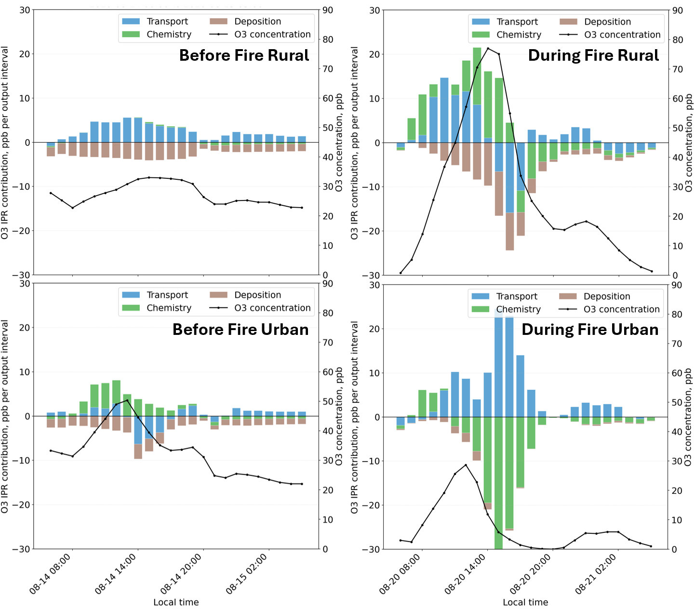
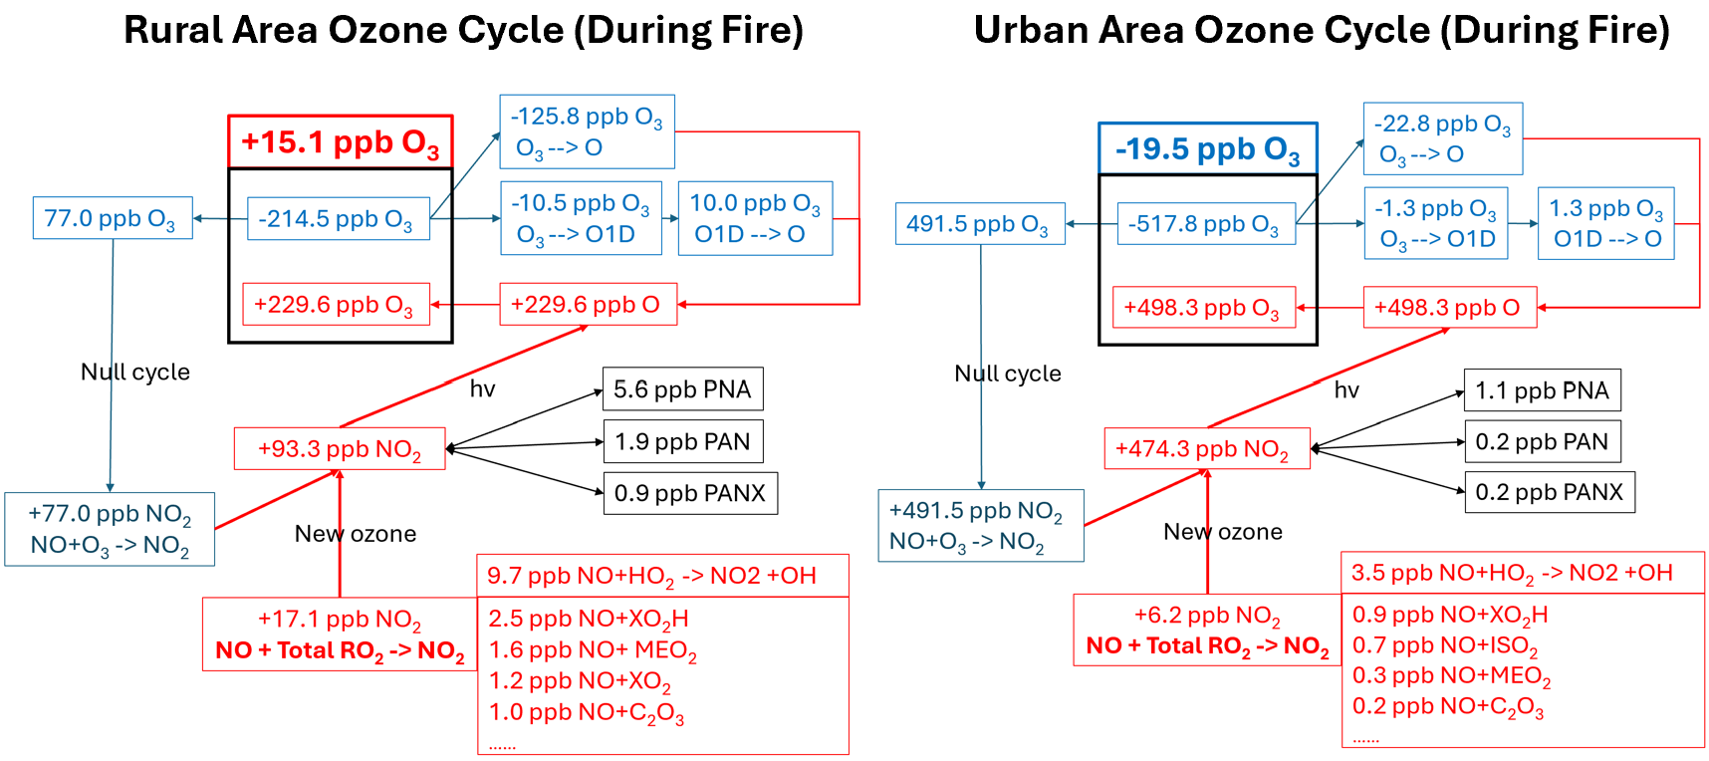
Forecasting Wildfire Ozone Is More Complex
Wildfire Smoke Can Increase or Decrease Ozone
Urban
Rural
a)
b)
Urban
Rural
c)
d)

Slide 14


Slide 15
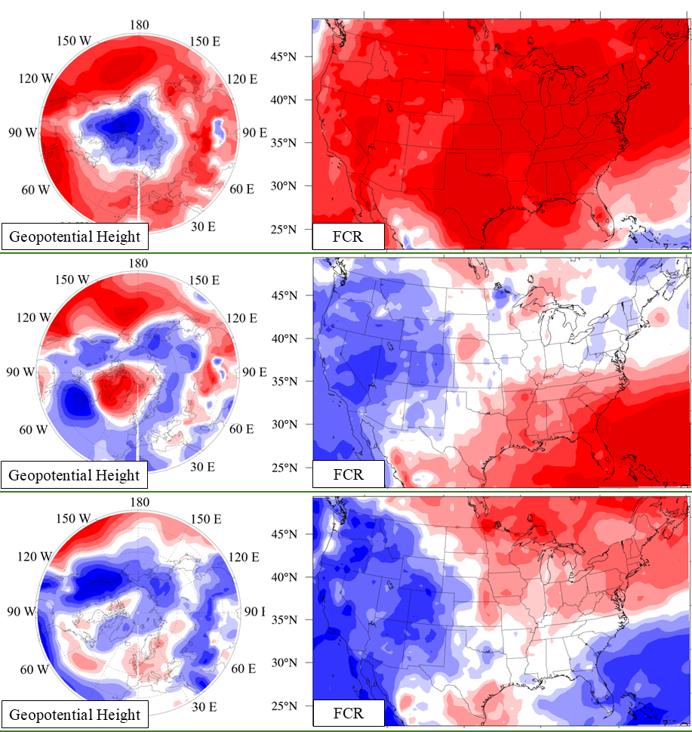
Extending Lead Time: Seasonal Smoke Outlooks
Climate variability modulates both fire emissions and smoke transport, creating predictable regional smoke patterns.
  La Niña: Broadly elevated smoke across CONUS
  -NAO: East–west smoke dipole
  -POL: North–south smoke dipole
Predicted climate modes can inform next-season regional smoke outlooks.
Fire PM
Fire PM
Fire PM

